Slide 1


Introduction to Git and GitHub
Fondren Library
Digital Scholarship Services

Slide 2

WHAT IS GIT?
The most widely used version-control system!
Remembers entire project history
Easily undo changes
Track contributions
Free and Open-Source Software
Fast & Simple
Optimized for collaboration
Non-linear development

Slide 3
WHAT IS GIT NOT?
Affiliated with GitHub (which is owned by Microsoft)
A file editor
A graphical user interface
Many user interfaces exist
Proactive
Must tell git about everything we do!

Slide 4


WHAT IS GITHUB?
The largest host for Git repositories
Free (for public repositories)
A great place to collaborate
Support for unique features
Comment sections
Organizations
Issue tracking
Extensible!

Slide 5
WHAT IS GITHUB NOT?
The only option
GitLab, Bitbucket, …
A version-control system
Everything is on top of git
Only for source code and programming
Difficult!

Slide 6
STRUCTURE OF A GIT REPOSITORY
Snapshots, Locality, File States

Slide 7
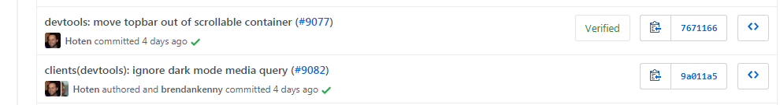
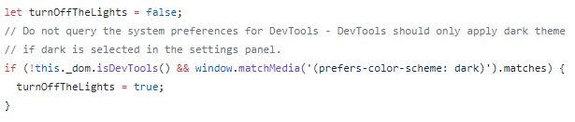

SNAPSHOTS
Sample Snapshot:
Can see all files present at any of these times!

Slide 8
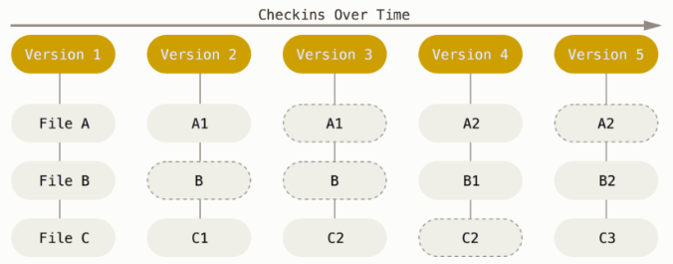
SNAPSHOTS
Stores the entire file structure at each snapshot, not a set of changes to one file!

Slide 9
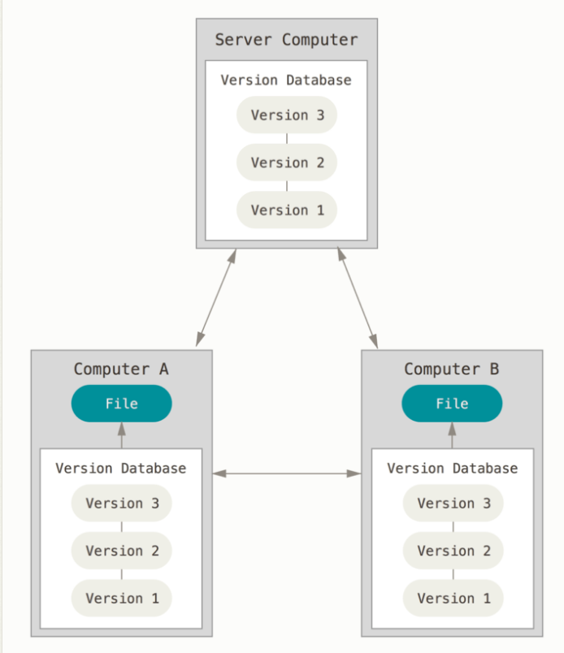
LOCALITY
Snapshots stored on your computer, not only on a server!
Hidden .git directory
Stores entire history of project (compressed!)

Slide 10
STATES OF FILES IN A REPOSITORY
untracked: git has not been told about this file.
modified: we told git about this file, but we've changed it without telling git to remember our change.
staged: we have told git about this file and told git we will want it to remember our change.
committed: we have made git take a snapshot of our file.

Slide 11
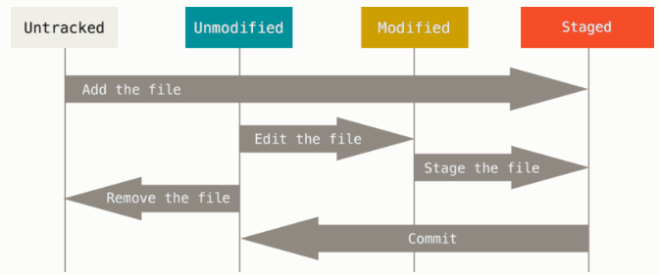
STATES OF FILES IN A REPOSITORY

Slide 12
CREATING & CLONING REPOSITORIES
Initialization & Copying from a server

Slide 13
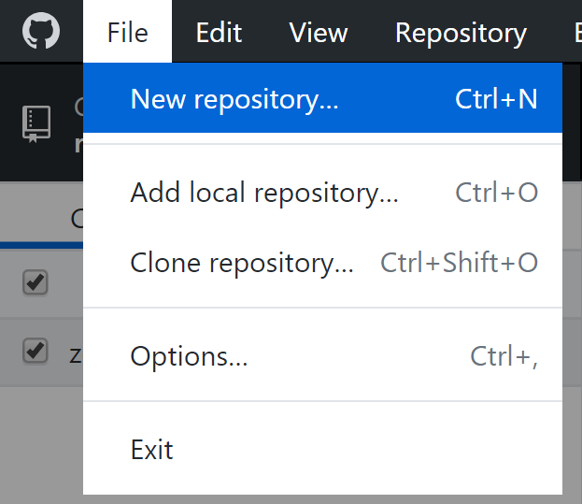
INITIALIZATION
Create a repository, with a file index and database
Stored in the hidden directory .git
Note: No files are added to the repository by default!
We’ll get to adding files a bit later

Slide 14
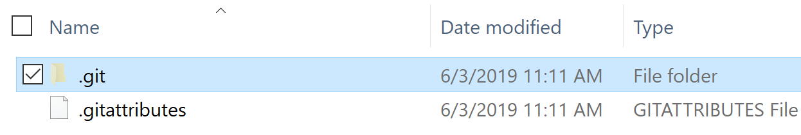
INITIALIZATION
Create a repository, with a file index and database
Stored in the hidden directory .git
Note: No files are added to the repository by default!
We’ll get to adding files a bit later

Slide 15
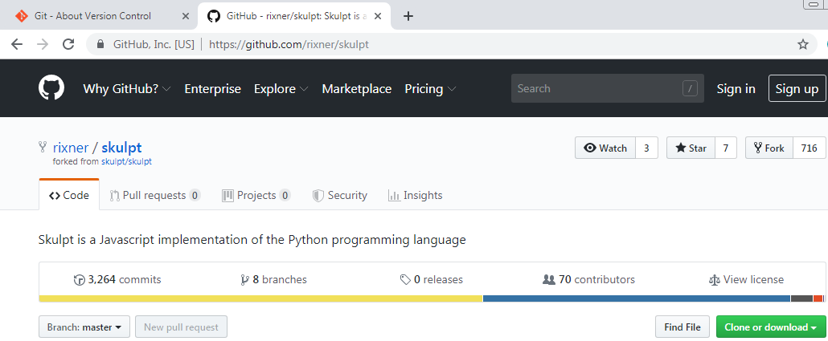
CLONING
Downloads entire history of a repository hosted on GitHub
Two ways to get the URL:

Slide 16
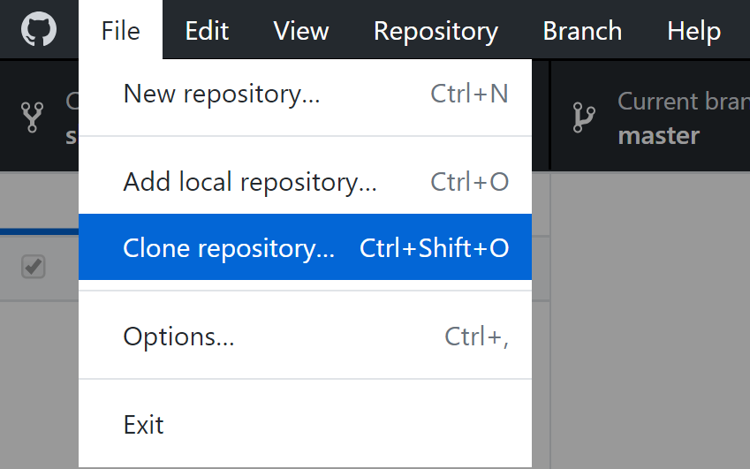
CLONING
Most recent snapshot immediately available
Full history needs to be downloaded as well. Takes time & space!

Slide 17
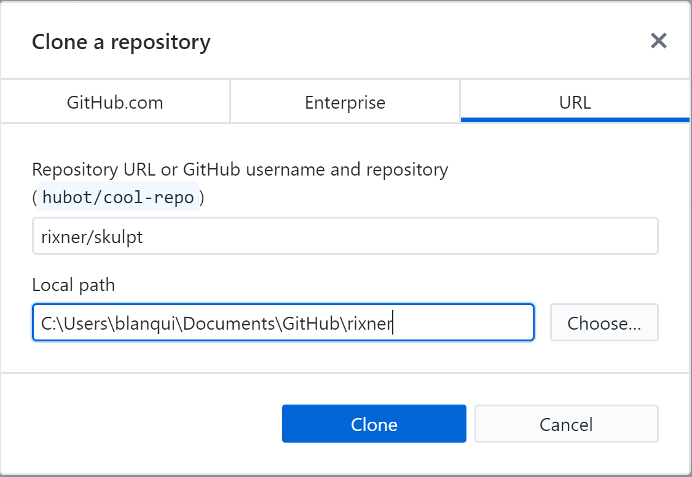
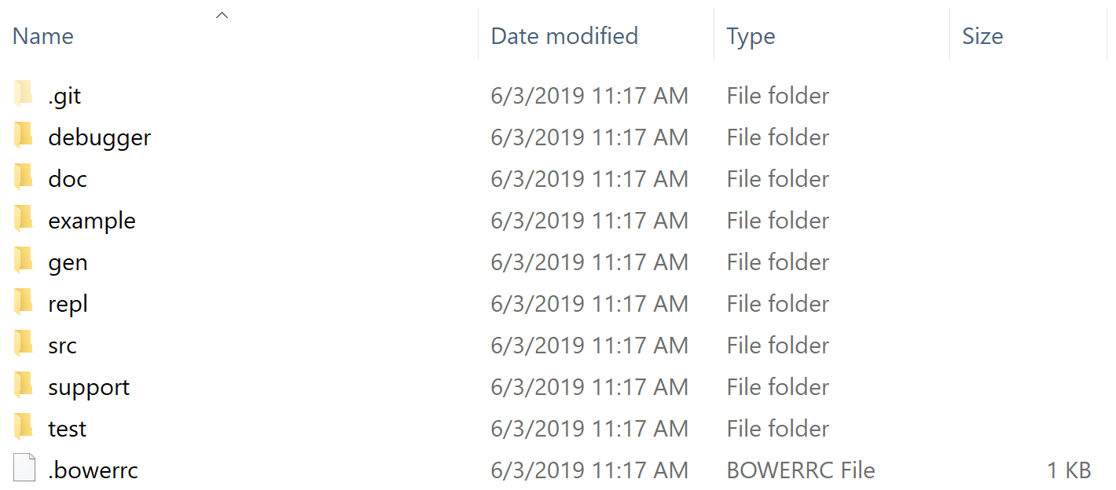
CLONING

Slide 18
CLONING
Clone this repository from GitHub now!
https://github.com/bakitybacon/rice-data-and-donuts-github

Slide 19
EDITING WORKFLOW
Editing, adding, staging, and committing

Slide 20
REVIEW OF FILE STATES

Slide 21
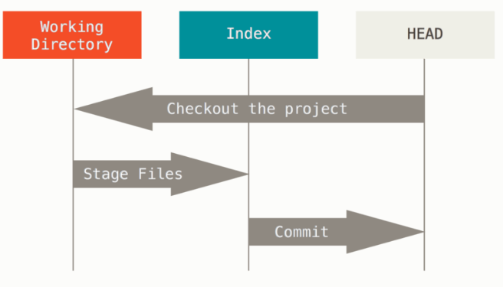
WORKFLOW
Working Directory
Changed files on disk.
Index
We’ve told git to pay attention to these changes.
HEAD
This is just the most recent commit (snapshot). You can come back here whenever!

Slide 22
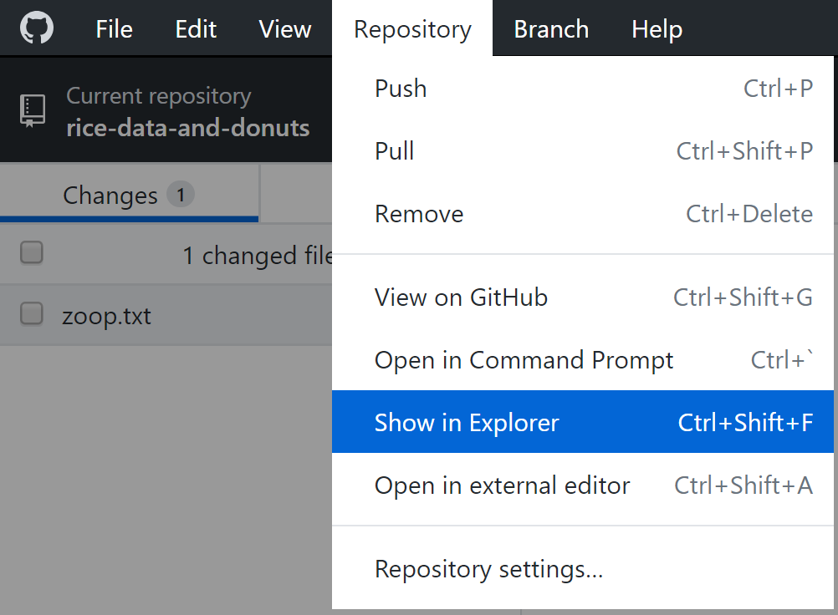
EDITING A FILE LOCALLY
Open and edit any file using any program
Use “Show in Explorer” to easily find the most recent files

Slide 23
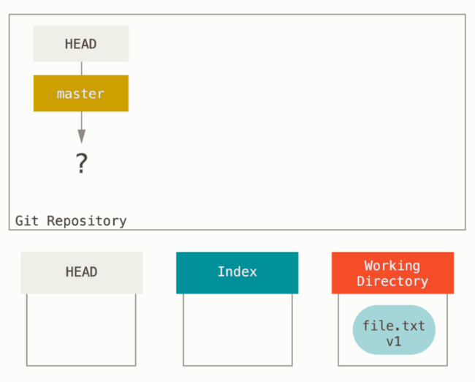
EDITING A FILE LOCALLY
Starting from an empty repository
How do we know?
HEAD doesn’t point to anything (no snapshots!)
We have edited a file in the Working Directory, but not yet told git to pay attention to it.

Slide 24
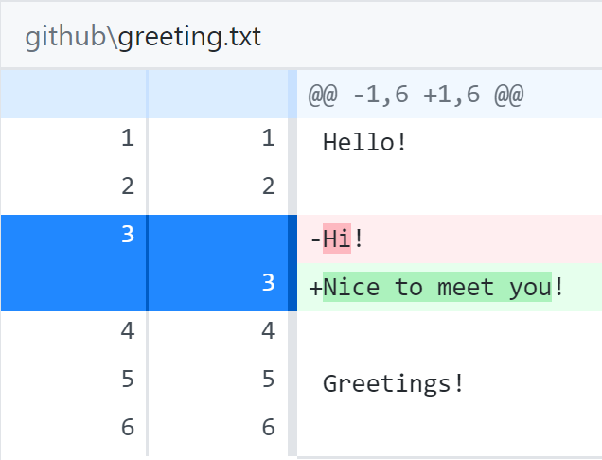
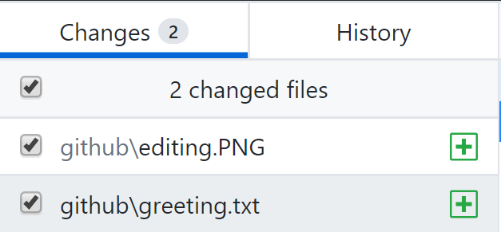
TELLING GIT ABOUT OUR CHANGES
Git will automatically find what we changed. All we have to do is tell it what we want to save
Toggle whether we want to add this change using check boxes
Monitor changes to text files
Green: added in
Red: taken out
White: not changed

Slide 25
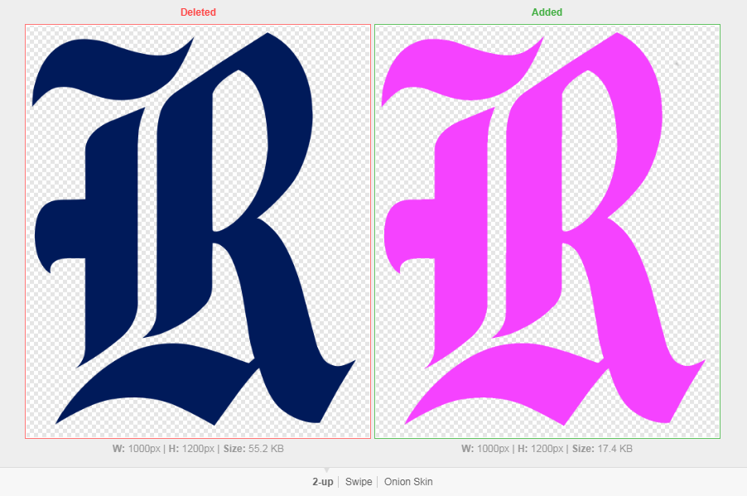
VIEWING CHANGES: IMAGES
2-Up: side-by-side
Swipe: left of divider is first image, right is second image
Onion Peel: images are overlaid, slider changes transparency setting

Slide 26
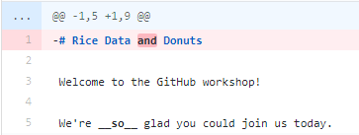
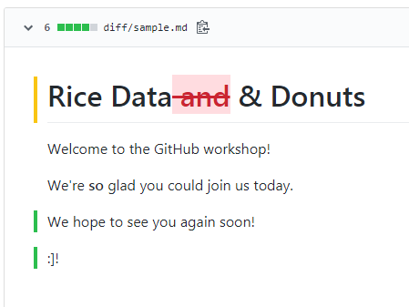
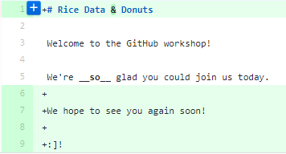
VIEWING CHANGES: DOCUMENTS
Prose Diff: see word-by-word changes in formatting

Slide 27
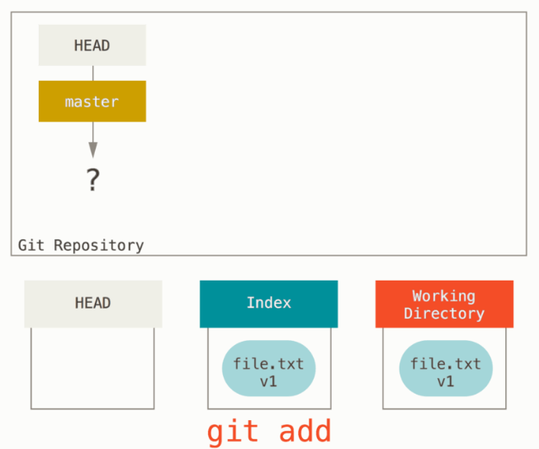
TELLING GIT ABOUT OUR CHANGES
Now that we have made file.txt, we can tell git to pay attention to the file
Transition between which two states for file.txt?
Command: git add
Whatever we have added will be changed in the new snapshot. No add means it won’t change!

Slide 28
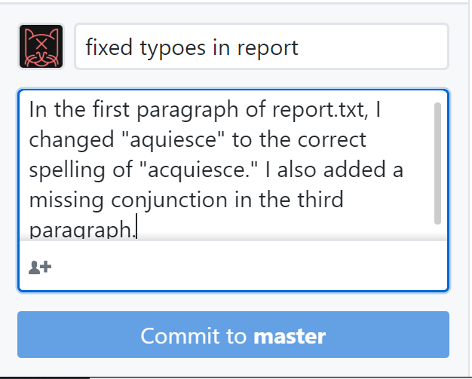
SNAPSHOTS OF OUR CHANGES
Once we have reached a milestone, or we just want to quickly and reversibly save our changes
Annotating our Snapshot
Short, simple summary. A few words
Extended description of approach. A few sentences
Only changes locally!

Slide 29
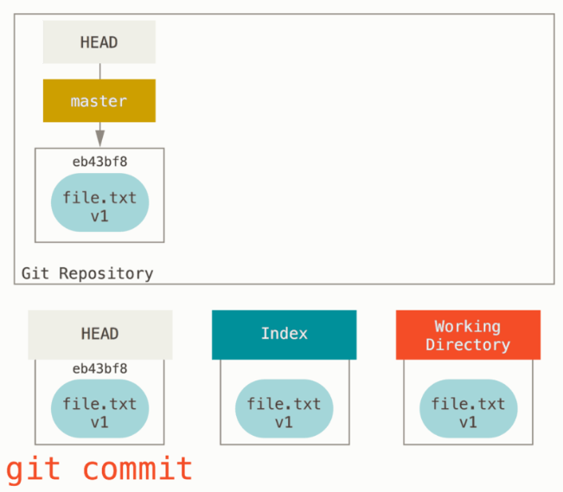
SNAPSHOTS OF OUR CHANGES
Tell git to take a snapshot of our files!
Transition between which two states for file.txt?
Command: git commit
HEAD now points to our most recent snapshot!

Slide 30
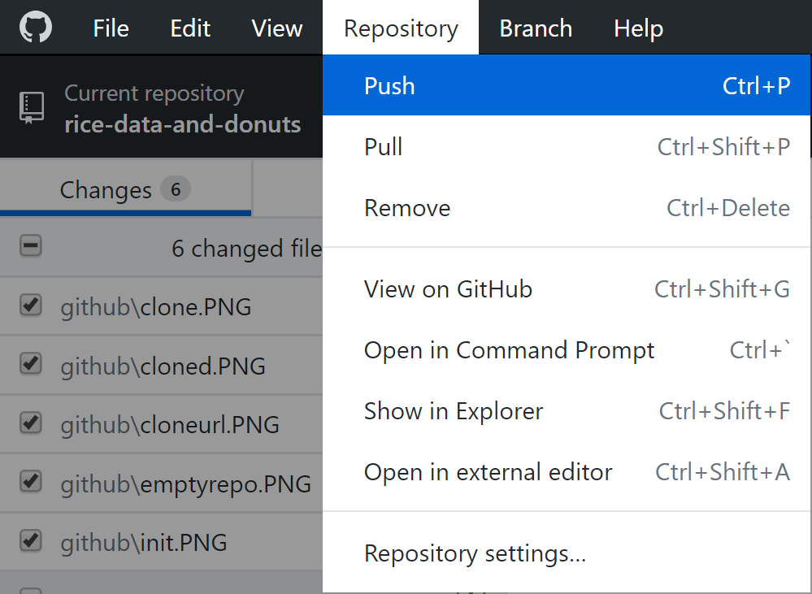
UPLOADING OUR CHANGES
Once we have a commit, we can send it to GitHub
This is called a push
Note: Changes are not sent to the server by default!

Slide 31
UPLOADING OUR CHANGES
From the repository cloned earlier, upload a file with any message you like!

Slide 32
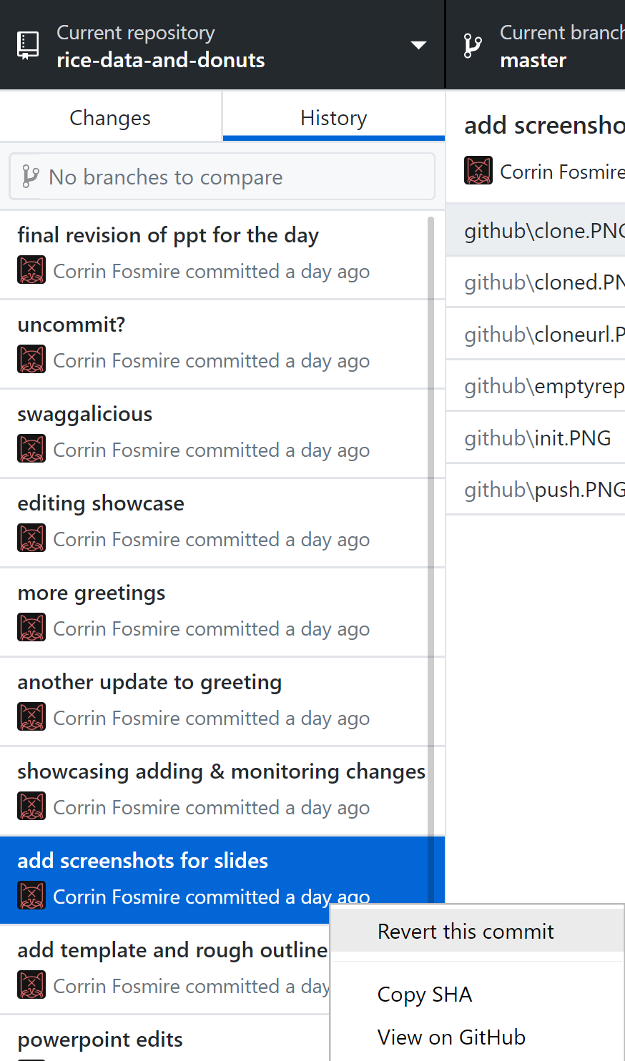
GOING BACK IN TIME
What if we accidentally made a change that deleted something we really needed?
Solution: Revert to a previous commit!
Note this doesn’t delete the changes after the revert

Slide 33
GOING BACK IN TIME
Revert your message, then commit something different and push again!

Slide 34
BRANCHES & MERGING
Creating, working on, combining, and switching branches

Slide 35
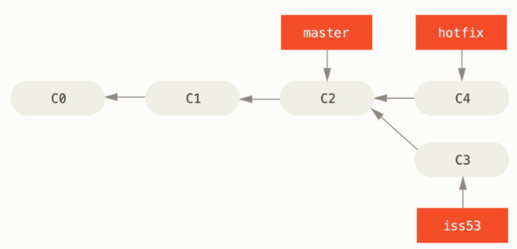
BRANCHES
If you’re working on different features or as part of a larger team
Divergent history
Independent files
Avoids unintended consequences!
Easy integration

Slide 36
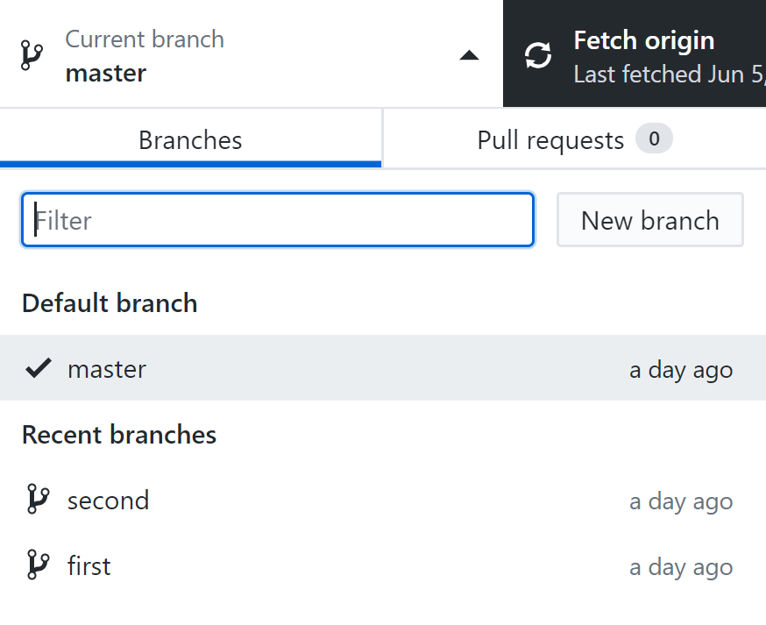

CREATING & SWITCHING BRANCHES
Click on the “Current branch” tab
If a branch isn’t listed, you may have to search for it
Make sure to publish the branch to GitHub!

Slide 37
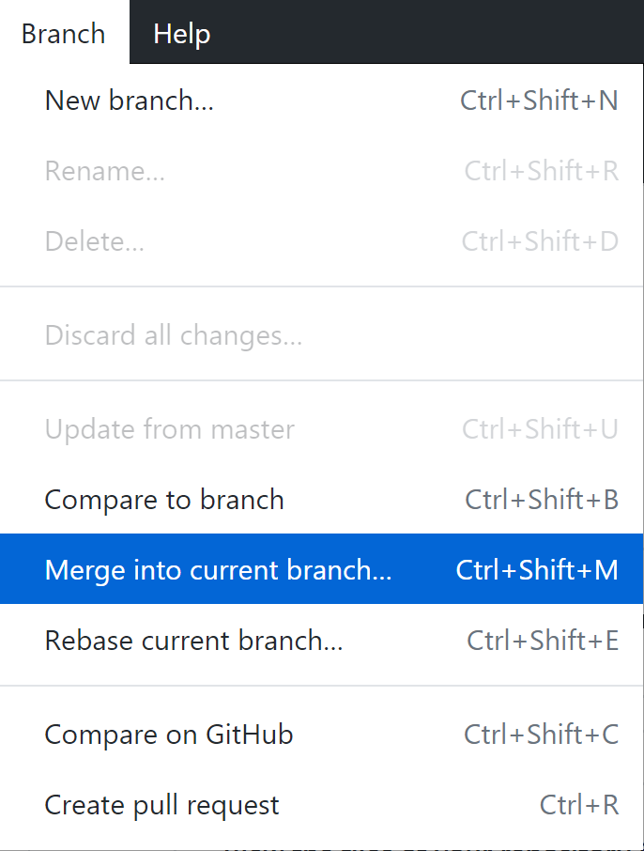
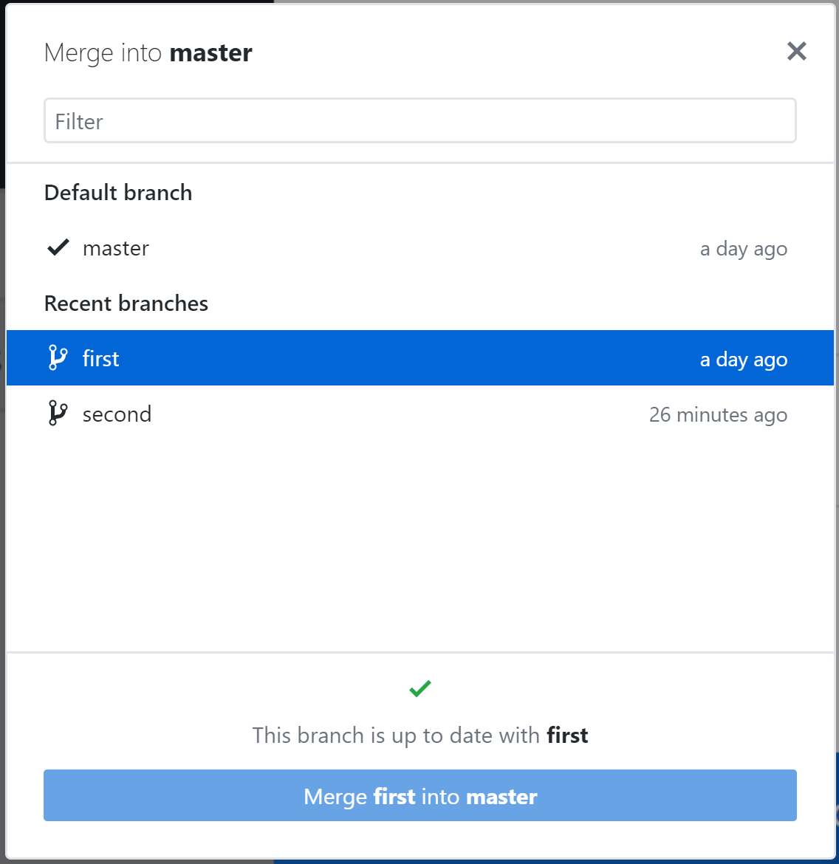
MERGING
Integrates changes that take place in a different branch
Usually goes smoothly if branches don’t overlap

Slide 38
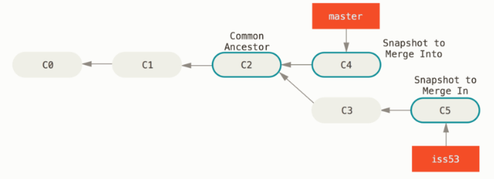
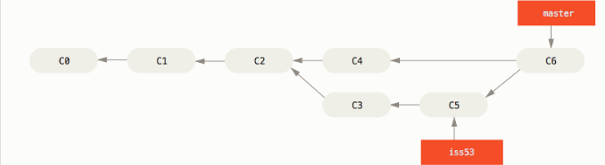
MERGING

Slide 39
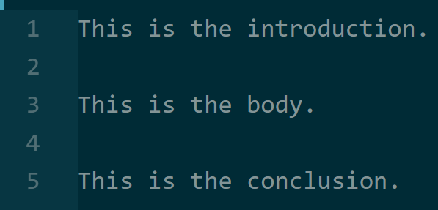
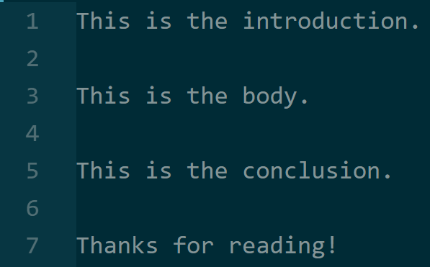
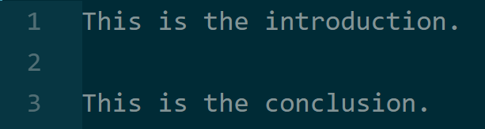
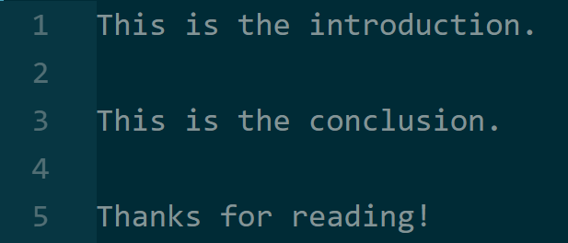
MERGING IN ACTION
Branch 1
(INTO)
Branch 1
(MERGED)
Branch 2
(IN)

Slide 40
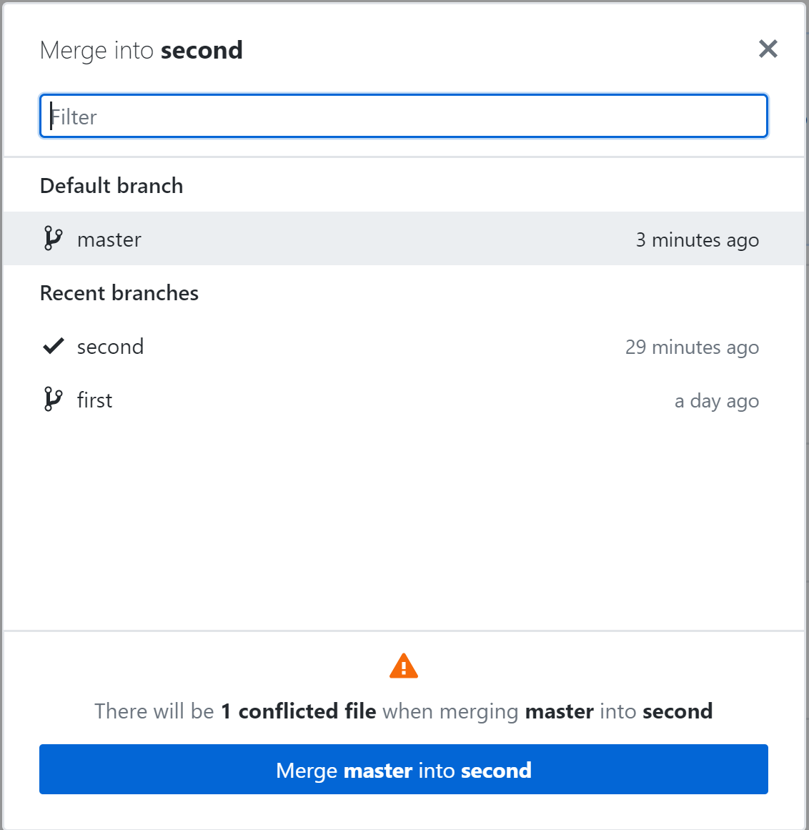
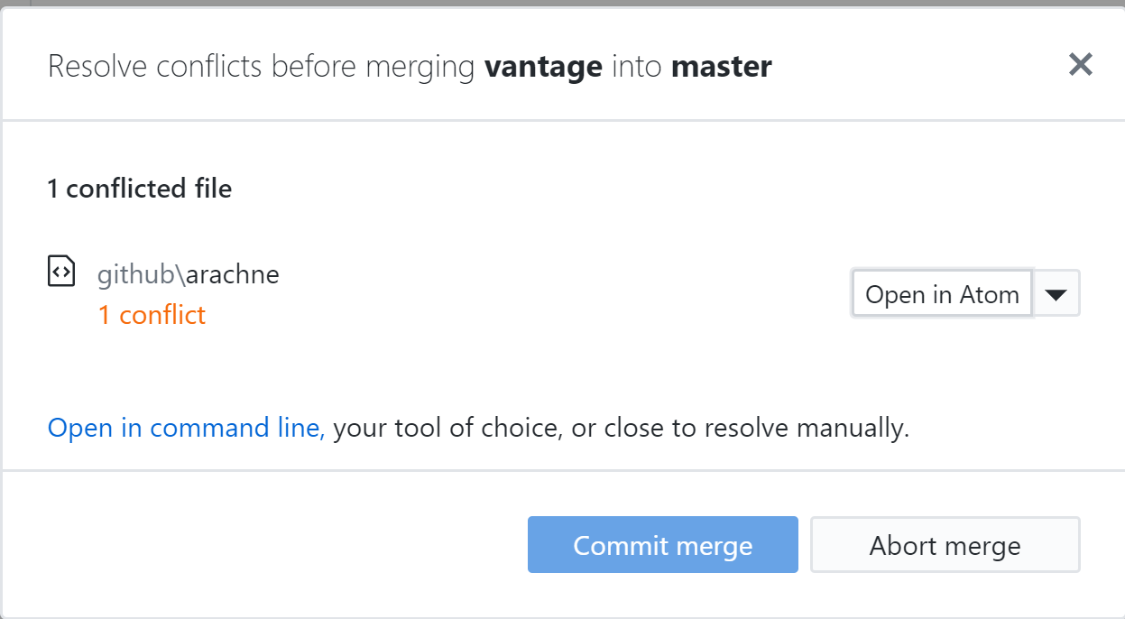
CONFLICTS
Occasionally, two people may have edited the same part of the same file on different branches
Which version do we take?
Must manually resolve conflicts

Slide 41
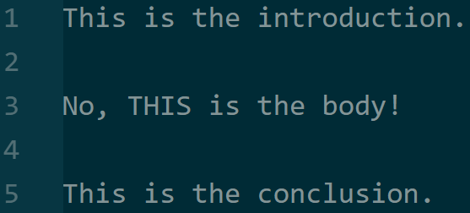
CONFLICTS IN ACTION
?

Slide 42
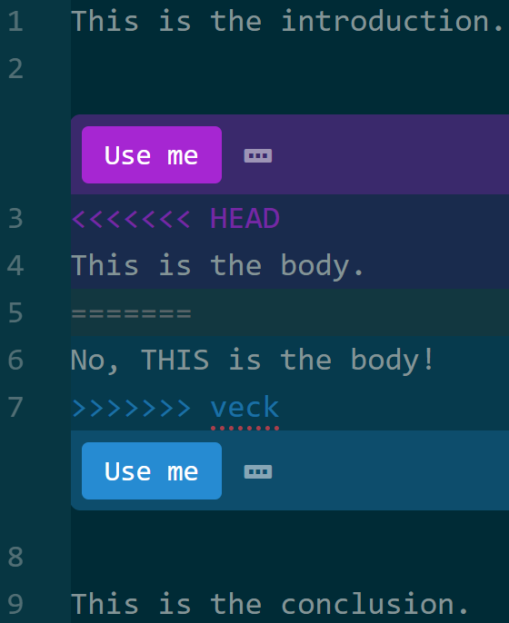
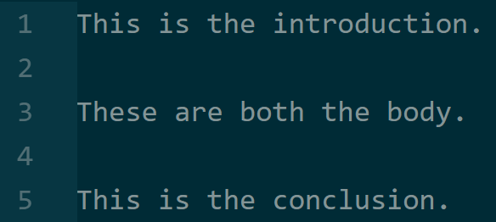
CONFLICTS IN ACTION

Slide 43
CONFLICTS AND MERGING
Create a new branch.
Edit community.txt to include only a one-line message.
Try to merge it.
If it fails, merge by combining the two messages. Don’t delete anyone else’s work!

Slide 44
ACKNOWLEDGMENTS
The figures are taken from Pro Git book, written by Scott Chacon and Ben Straub and published by Apress, used under the terms of the Creative Commons Attribution-NonCommercial-ShareAlike 3.0 Unported License.
The GitHub Mark and Octocat are used under their official license (https://github.com/logos)
The Git logo is used under the Creative Commons Attribution 3.0 Unported License.
Screenshots are taken from GitHub Desktop and Atom.

